Slide 1
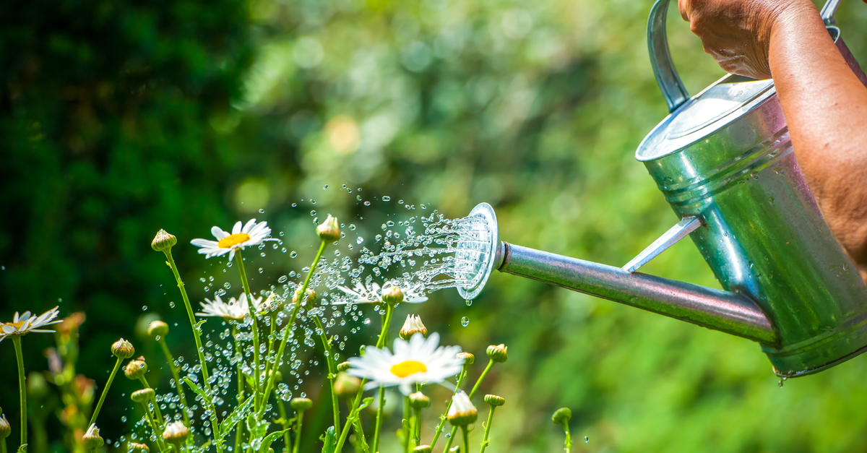
The WaterMinder
By Varsha Sundar and Arrnavv Chawla

Slide 2
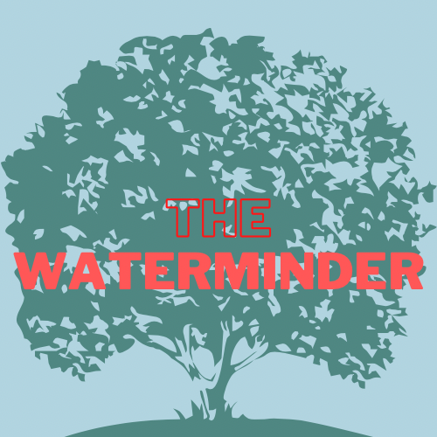


IDEA
Plants are extremely essential to human life and without them the earth would be inhabitable. Creating a project that, on a small and achievable scale, helps increase or achieve sustained greenery. The Sustainable Development Goals in our focus are SDG 13 and SDG 15.

Slide 3
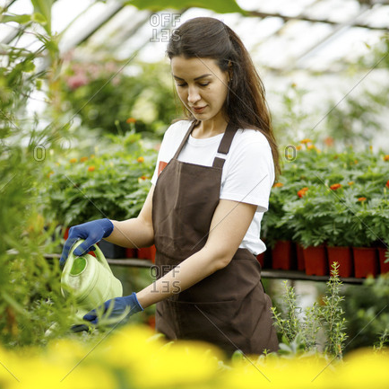
PROBLEM STATEMENT
A problem statement that we devised was related to the watering of pots in households. It is estimated that over 30% of household potted plants die every year due to lack of water. So we needed to make a device that reminds a person to water their plants. That too at the correct time. A device that recommends a person as to when to water a plant.

Slide 4
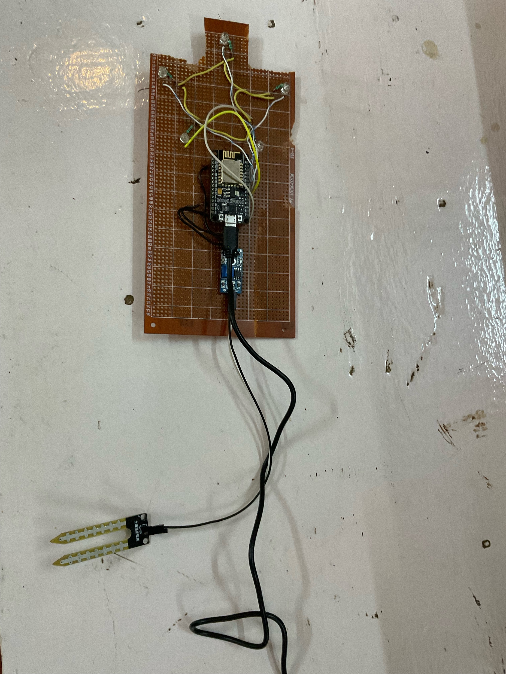
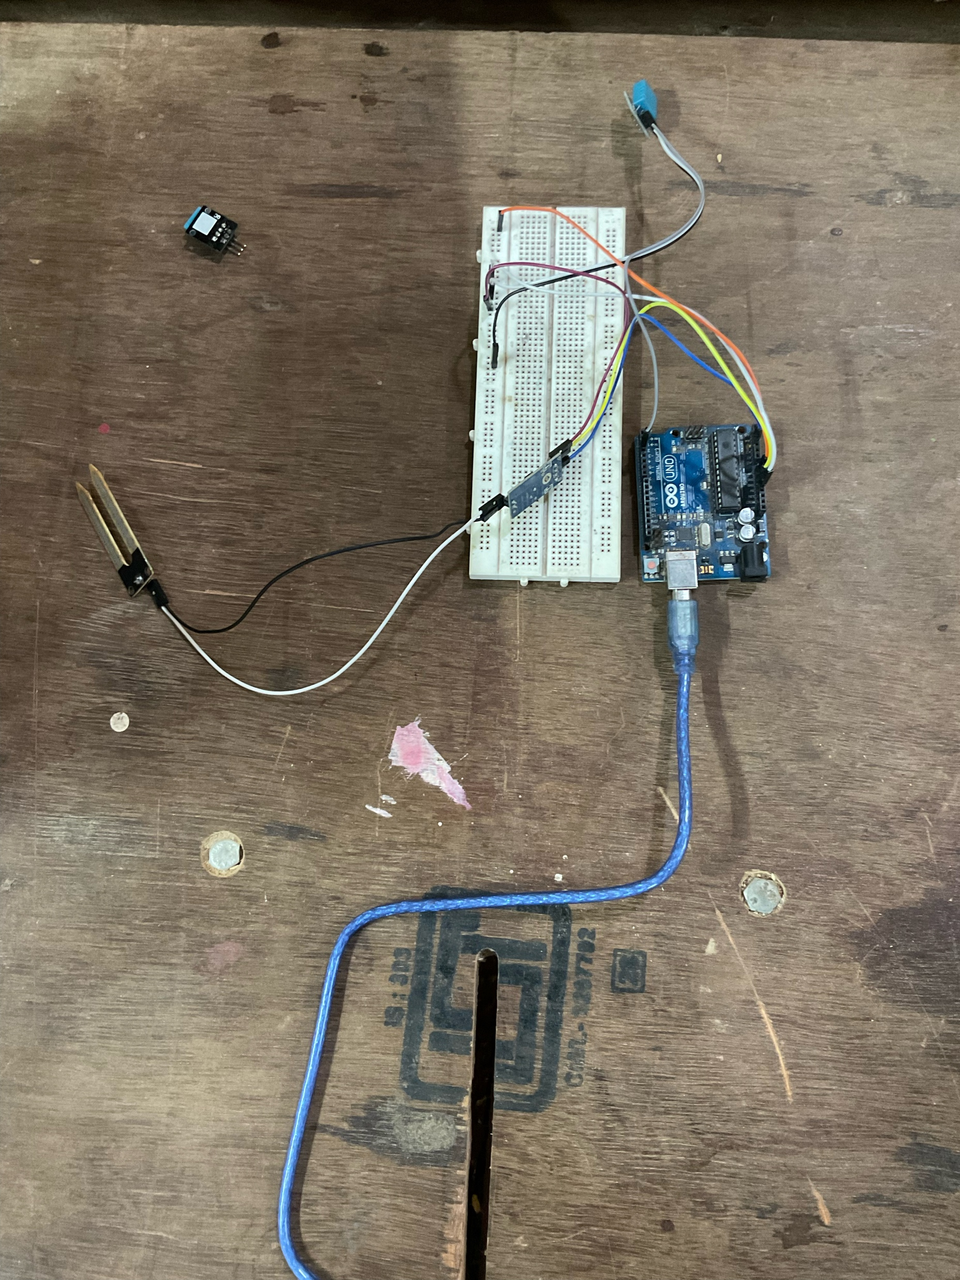
SOLUTION
We came up with a project that has a soil moisture sensor connected to an ESP8266 circuit board. Based on the moisture readings, it determines whether the soil is underwatered or perfect and then flashes LEDs and messages you on Telegram.

Slide 5
